Slide 1
Greek Ethics
Chapter 1
A Comprehensive History of Western Ethics

Slide 2
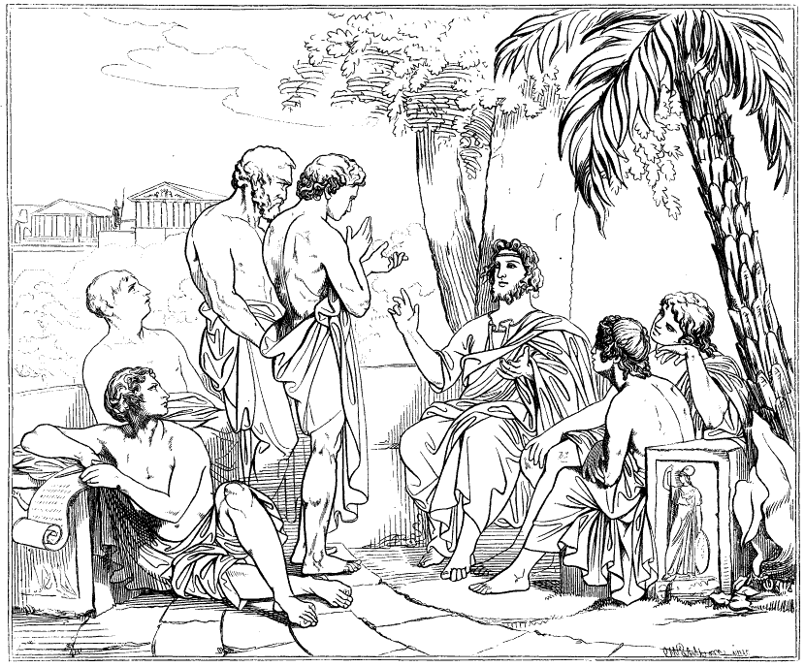
Ancient Greece: The Sophists
The growing demand for education in 5th century BCE Greece called into existence a class of teachers known as sophists.
They were a professional class rather than a school, and as such they were scattered over Greece and exhibited professional rivalries.
The educational demand was partly for genuine knowledge, but mostly reflected a desire for spurious learning that would lead to political success.
They wandered about Greece, gave lectures, took pupils, and entered into disputations.
For these services they exacted large fees, and were the first in Greece to take fees for teaching wisdom.

Slide 3
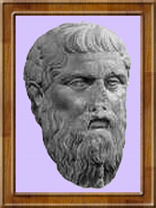
Ethics of the Sophists
As in the case of the problem of knowledge, by defending relativism they ended in Skepticism; so also in the question of morals, by the same subjectivist prejudice they end in utilitarianism and hedonism.
Thus, that is good which satisfies one's instincts and passions.

Slide 4
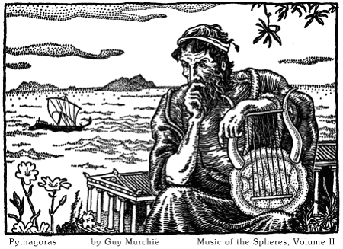
Sophists: Might Makes Right
The Sophist also violently attack the traditional belief about right -- that derivation from principles based on justice -- and they substitute the concept of force for that of justice.

Slide 5
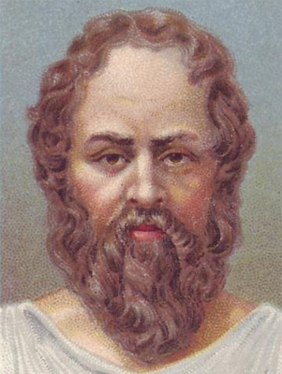
Socrates: Virtue = Knowledge
In ethics, Socrates did not surpass the prejudice of Greek intellectualism, which made the practice completely dependent upon theory.
It is enough to know virtue in order to be virtuous.
Everyone wishes to be happy.
If he does not attain happiness, it is because he does not know the way that leads to happiness.
Consequently, so-called evil men are in reality only ignorant; the evil is reduced to error.

Slide 6
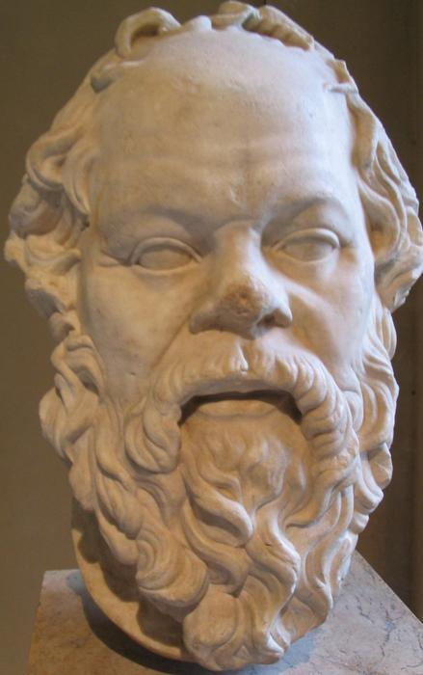
Socrates
As vice is synonymous with ignorance, so knowledge of the good is synonymous with virtue.
Thus it is easy to see why Socrates, who intended to form a virtuous youth, restricted his teaching to the search for moral concepts.
It is to be noted that moral intellectualism is present in all Greek thought, including the great ethical systems of Plato and Aristotle.

Slide 7
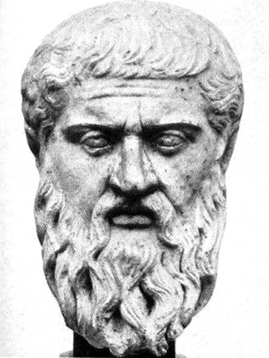
Plato’s Ethics
The ethics of Plato is an application in practice of the principles which had been reached in the metaphysical field.
We know that the soul, which was happy in the contemplation of the ideal world, now finds itself imprisoned in the body and impelled by the pleasures of sense.
To give in to these impulses would mean to strengthen yet more the bonds with matter and to render oneself ever more distant from true happiness, which is in the world of Ideas.

Slide 8
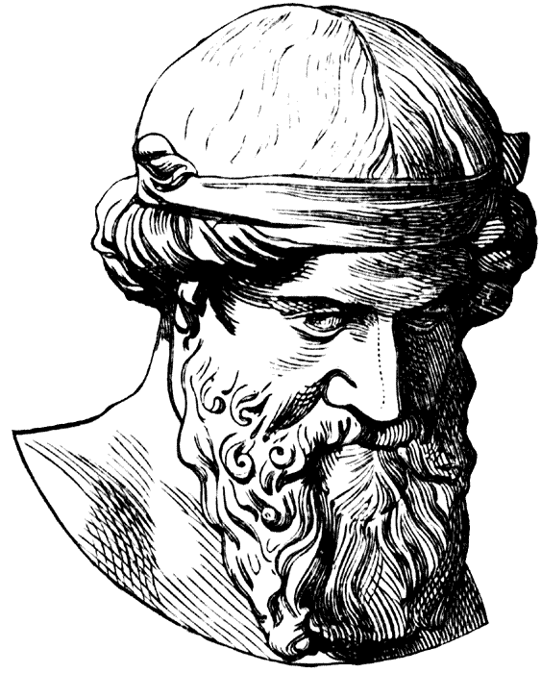
Ethics of Plato
The most fruitful source of Plato’s ethical theory is found in his REPUBLIC.
Ethical knowledge is even more austere than mathematics.
“The idea of the good is the highest knowledge.”

Slide 9
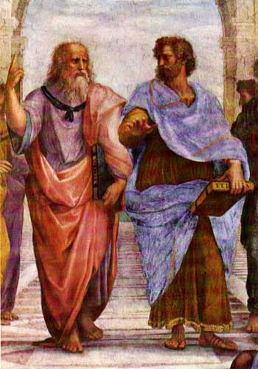
The “Good”
The Good is identified as the philosopher’s ultimate object of contemplation.
The Good is the purpose of the world and its essential being.
The Good is God.

Slide 10
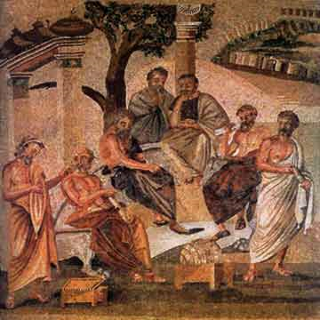
The “Good”
The Good, as man’s highest ideal, must be brought into realization by man perfecting himself.
The good is the final cause of the world for which all thing strive.

Slide 11

PLATO: Four Cardinal Virtues
WISDOM
COURAGE
TEMPERANCE
JUSTICE

Slide 12
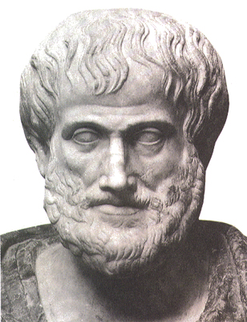
Aristotle’s Ethics
We study ethics in order to improve our lives, and therefore its principal concern is the nature of human well-being.
Aristotle follows Socrates and Plato in taking the virtues to be central to a well-lived life.

Slide 13
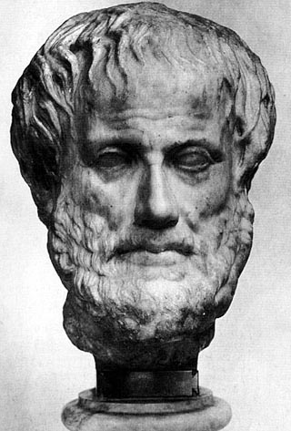
Aristotle’s Ethics
Like Plato, he regards the ethical virtues (justice, courage, temperance and so on) as complex rational, emotional and social skills.
But he rejects Plato's idea that a training in the sciences and metaphysics is a necessary prerequisite for a full understanding of our good.

Slide 14
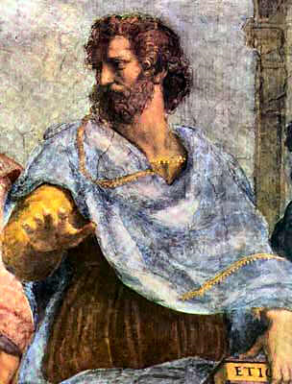
Virtue = Habits of Good Choice
What we need, in order to live well, is a proper appreciation of the way in which such goods as friendship, pleasure, virtue, honor and wealth fit together as a whole.
In order to apply that general understanding to particular cases, we must acquire, through proper upbringing and habits, the ability to see, on each occasion, which course of action is best supported by reasons.

Slide 15

Eudaemonia [Happiness]
For human beings, eudaemonia is activity of the soul in accordance with arete (excellence, virtue, or what it's good for).
Eudaemonia is living well and doing well in the affairs of the world.

